Slide 1
Artificial and machine learning-based CAREER GUIDANCE TOOL
PRESENTED BY:
ABINAYA.R

Slide 2
ABSTRACT:
The AIML-based career guidance tool utilizes artificial intelligence and machine learning to deliver personalized career advice tailored to individual users. By analyzing skills, interests, academic performance, and real-time labor market trends, it provides customized career pathways and educational recommendations.
The tool enhances user engagement and decision-making, empowering students and job seekers to make informed career choices and adapt to evolving job markets

Slide 3
Existing systems
Manual Counseling: One-on-one sessions with career counselors who provide advice based on their experience and knowledge.
Standardized Tests: Use of standardized aptitude and personality tests to determine suitable career options.
Static Databases: Access to job databases and career information that do not account for individual preferences or real-time labor market changes.
Limited Personalization: Recommendations are often generic and not tailored to individual needs, interests, and evolving career goals.
Time-Consuming: The process of gathering information and receiving feedback can be lengthy and inefficient.

Slide 4
Proposed systems
Personalized Recommendations: Using AI algorithms to analyze user profiles, including skills, interests, education, and work experience, to offer tailored career advice.
Real-Time Labor Market Analysis: Incorporating real-time labor market data to ensure recommendations align with current job trends and demands.
Adaptive Learning: Utilizing machine learning to continuously improve the accuracy and relevance of career recommendations based on user interactions and feedback.
Natural Language Processing (NLP): Implementing NLP to understand user queries and intuitively provide relevant information and advice.
Skill Gap Analysis: Identifying gaps in the user's skillset and recommending specific courses, and certificate training programs to enhance career

Slide 5
TOOLS FOR IMPLEMENTATION AND ITS JUSTIFICATION
Python :
Widely used for AI/ML due to simplicity Pandas, NumPy (data analysis), and TensorFlow, (machine learning).
Java script:
Enhances user experience by enabling dynamic content and interactivity.
TensorFlow:
For building and deploying machine learning models.
NLTK (Natural Language Toolkit):
For processing and analyzing text data.
HTML/CSSOverview:
The foundational languages for web development are Structure (HTML) and style (CSS) the user interface of career guidance tools.

Slide 6
Natural Language Processing (NLP) Tools:
NLTK (Natural Language Toolkit): For processing and analyzing text data.
spaCy: For advanced NLP tasks, including named entity recognition and part-of-speech tagging.
BERT (Bidirectional Encoder Representations from Transformers): For understanding context and improving the accuracy of text-based user inputs.
Data Storage and Management:
SQL Databases (e.g., PostgreSQL, MySQL): For structured data storage
NoSQL Databases (e.g., MongoDB, Firebase):
For unstructured data and flexible schema design.
Data Lakes (e.g., Amazon S3, Google Cloud Storage): For storing large volumes of raw data.
Data Processing and Analysis:
Pandas: For data manipulation and analysis.
NumPy: For numerical operations and data manipulation.
Apache Spark: For processing large datasets and performing big data analytics

Slide 7
Module:
Data Collection and Preprocessing
Objective
Gather and clean data on various careers, skills, job market trends, and user profiles.
Tasks:
Collect data from job portals, career websites, and surveys.
Clean and preprocess the data to remove inconsistencies and irrelevant information.
Career Information Module
Objective:
Provide detailed information about various careers.
Tasks:
Create a database of career profiles, including job descriptions, required skills, salary ranges, and growth prospects.
Allow users to search and explore different career options.

Slide 8
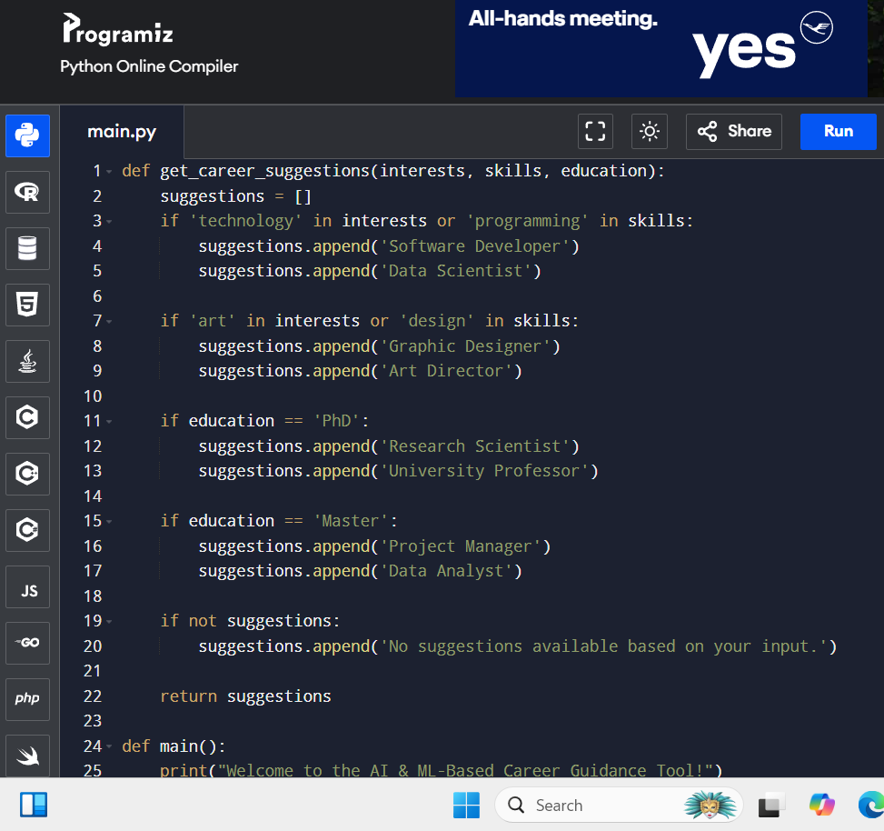
PROGRAM:
.
.

Slide 9
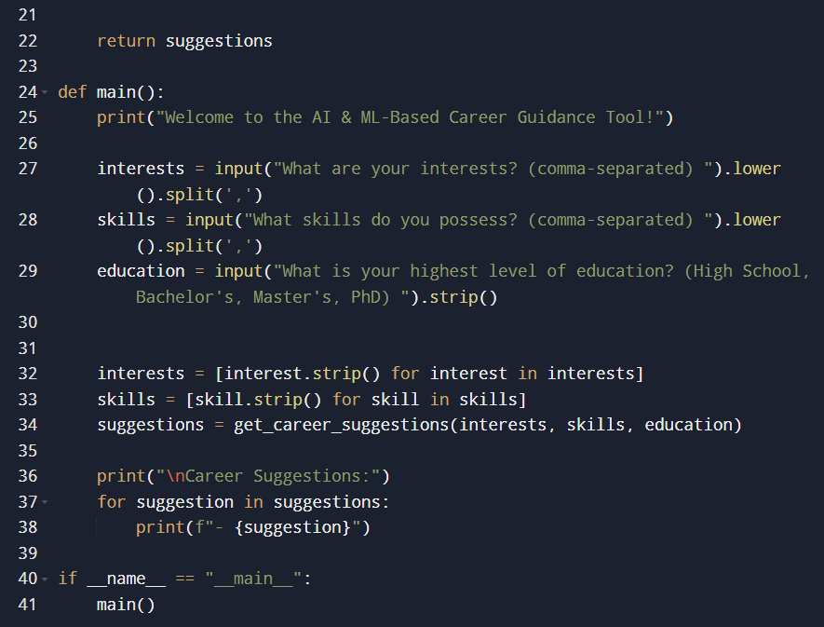
.

Slide 10
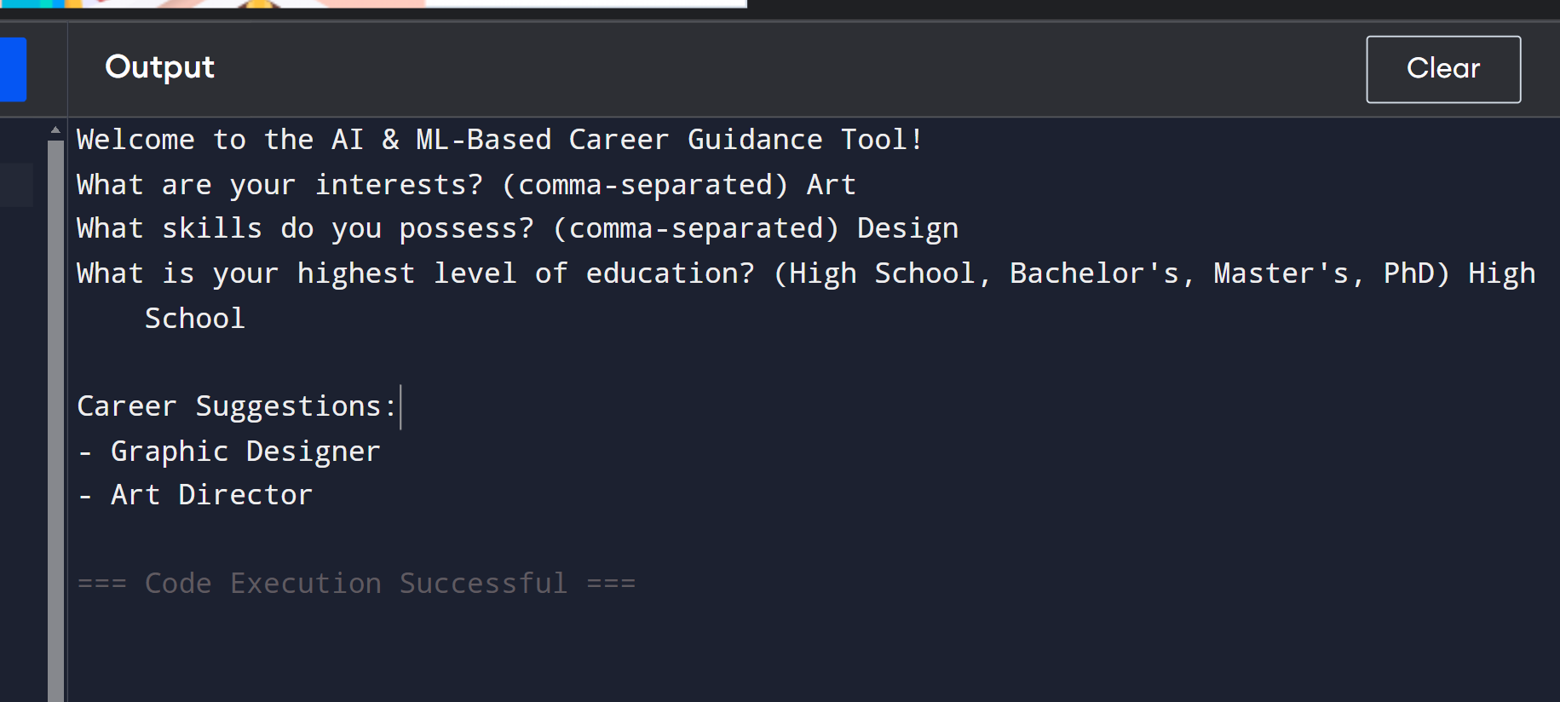
SAMPLE OUTPUT:

Slide 11
Integration and Deployment
Objective:
Integrate all modules and deploy the application.
Tasks:
Integrate the backend with the frontend.
Deploy the application on a cloud platform like AWS, Azure, or Google Cloud.
Feedback and Improvement Module
Objective:
Collect user feedback to improve the system
Tasks
Implement feedback forms for users to rate the recommendations and provide suggestions
Use feedback to refine the recommendation algorithms and improve accuracy.

Slide 12
CONCLUSION
Based on your interests, skills, and the insights provided by our AI-driven analysis, pursuing a career in data science appears to be a highly suitable path for you. Strengthening your programming skills and gaining experience through internships or projects will further enhance your prospects. The demand for data scientists is expected to grow significantly over the next decade, providing a stable and lucrative career. We encourage you to continue developing your technical and soft skills to stay competitive in this evolving field. Best of luck in your career journey.

Slide 13
THANKYOU!!!

